Slide 1
Amazon Food Review Analysis
Analytics for Unstructured Data
Xinyu (Sharon) Liu

Slide 2
Problem Statement
When customers purchase products online, product review is an important element that help them make buying decisions
We are trying to find:
What makes a review positive/ negative? What are some commonalities in Good reviews/Bad reviews?
What are the common topics people write review about?
Purpose:
Help Amazon sellers make good product selection and improve product description.

Slide 3
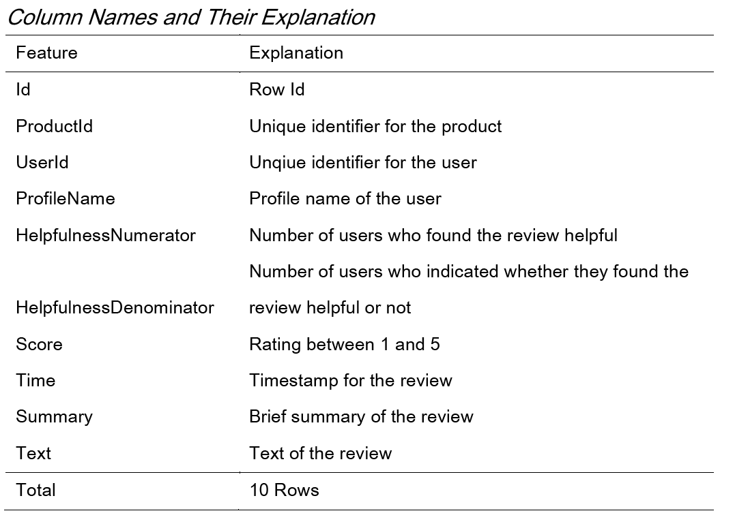
Data Description
Data Source
Pre-scraped reviews of fine food from Amazon
Contains data of over 10 years
Include product, user information, ratings, reviews, etc.
This dataset includes
568k reviews
256k users
74k products
Notes:
Dataset link: https://www.kaggle.com/datasets/snap/amazon-fine-food-reviews?datasetId=18&sortBy=voteCount

Slide 4
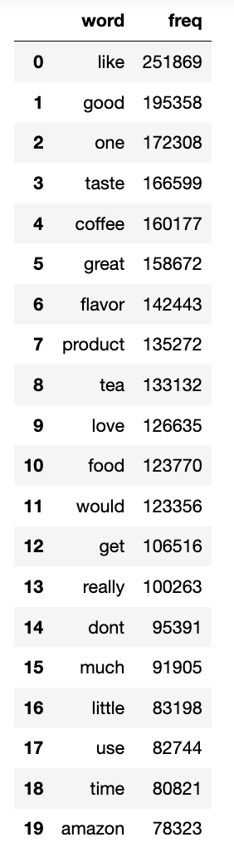
Data Pre-Processing
- dropped duplicate reviews
- dropped useless columns
- dropped rows with NULL values (27 out of 568k is NULL)
- text preprocessing ( on REVIEW column):
- tokenized and made all texts lower case
- removed punctuation, stop words, URLs, Emojis
- created column (‘good review’):
0: Reviews have score 1 or 2
1: Reviews have score 3 or 4 or 5
Frequency of Important Words

Slide 5
Sequence of Analysis
Sentiment analysis
Polarity + subjectivity score for reviews
Relationship between ratings and sentiment
Distribution of polarity and subjectivity score
Special case: good reviews with very negative polarity
LDA Topic modeling
Topic modeling with all reviews
Topic modeling with all NOUNS in reviews

Slide 6
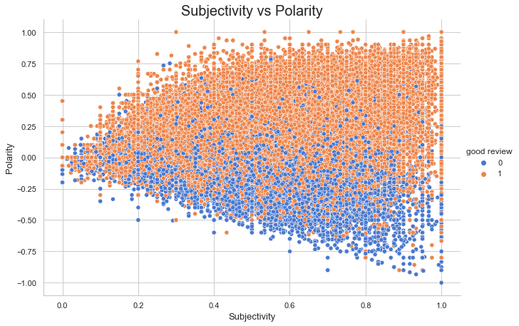
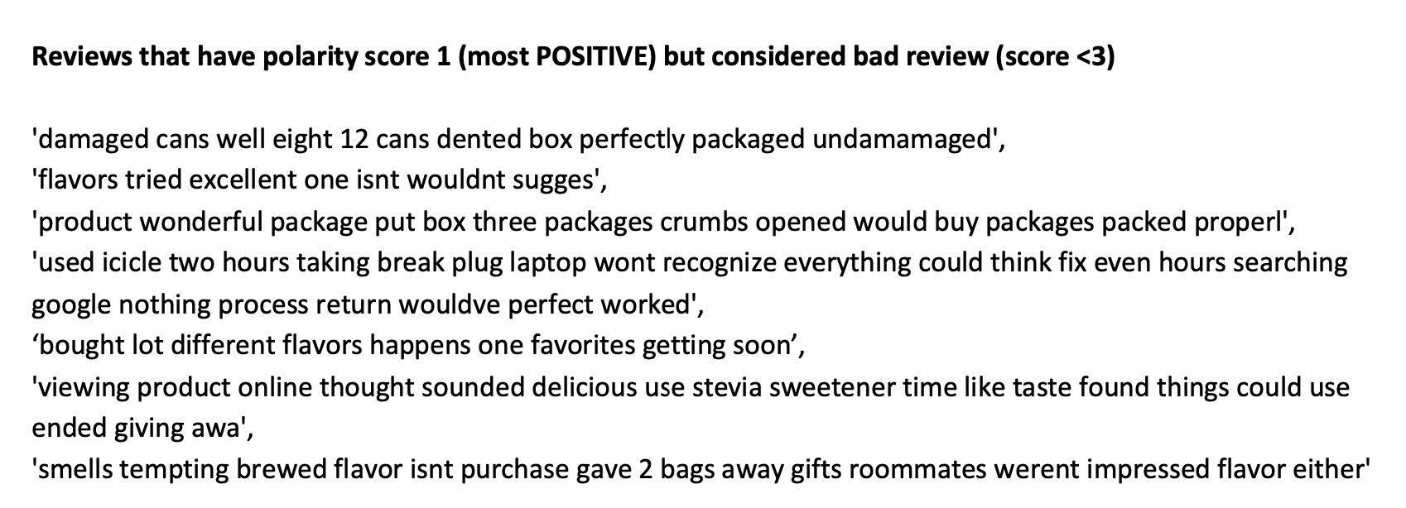
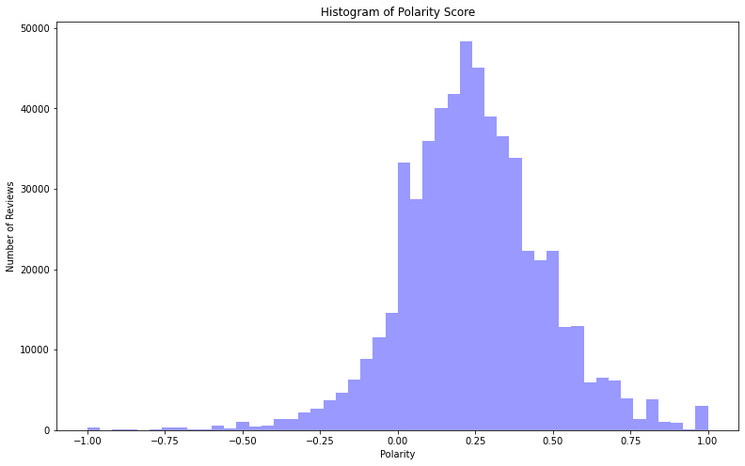
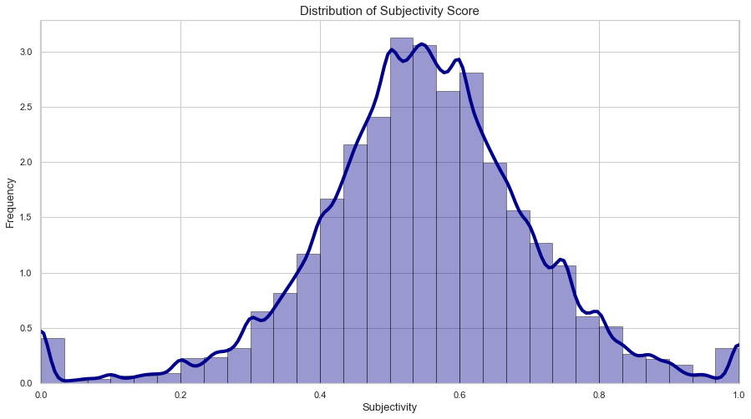
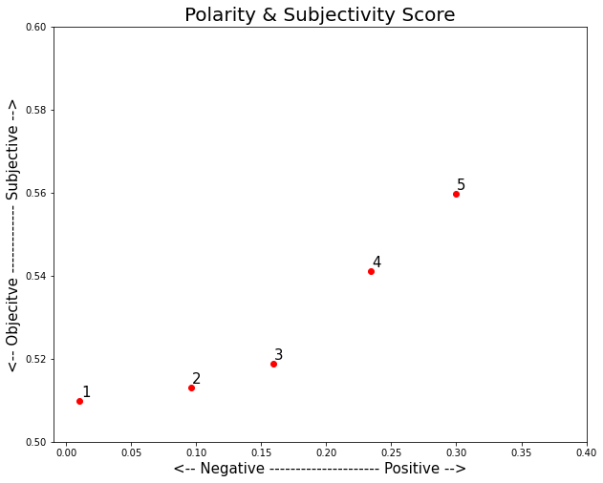
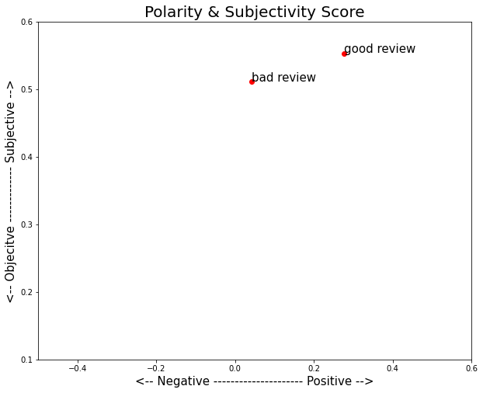
Sentiment Analysis

Slide 7
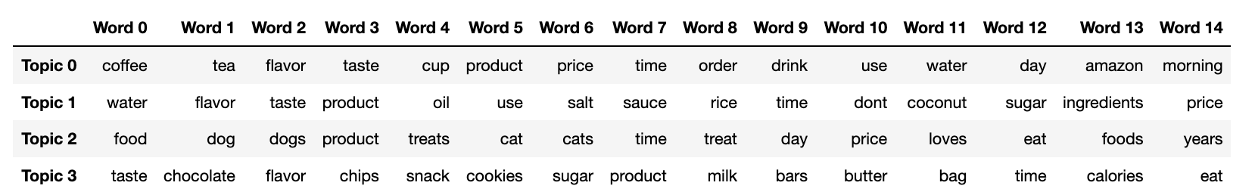
Topic Modeling
Four main topics:
Beverage
Ingredients
Pet items
Snacks

Slide 8
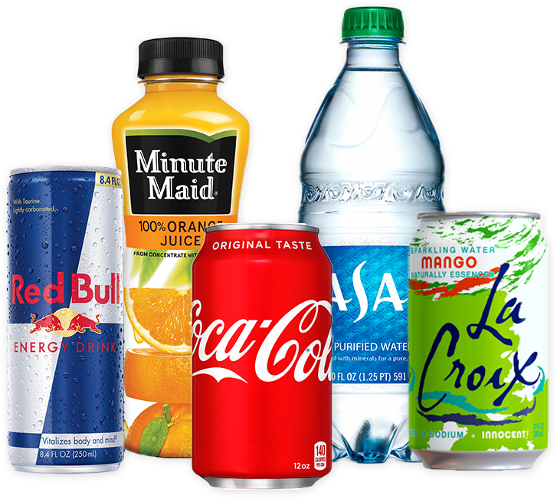


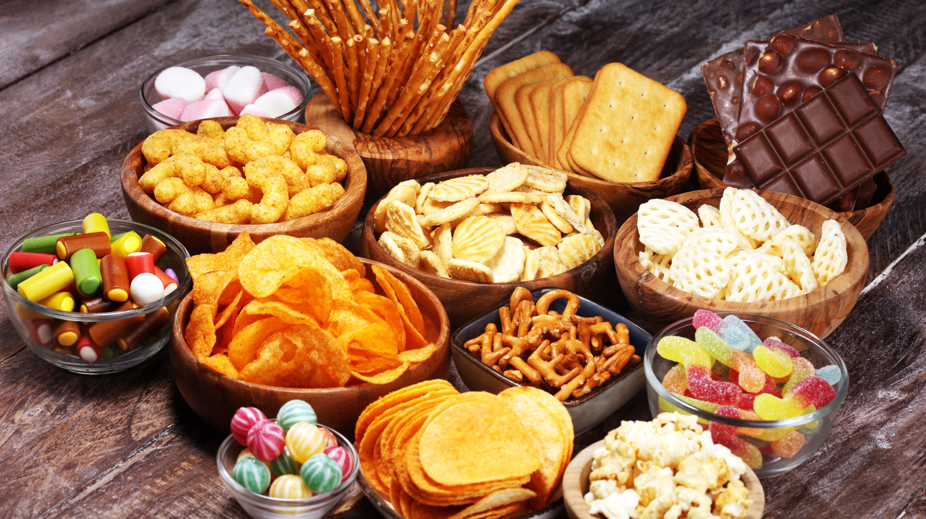
Recommendation
If a new seller is trying to enter the marketplace, he or she can utilize our analysis to sell products related to one of the listed topics (beverages, ingredients, pets items, snacks). On the other hand, he or she might also need to face a more competitive market.

Slide 9
Future Steps
Interpreting emojis: For this project, we removed all the emojis in the text reviews. However, the interpretation of emojis might be extremely useful especially for sentiment analysis to classify good and bad reviews, they are strong indicators of emotions
Pre-Processing misspelled words in the review texts: In Amazon reviews, many words sent by users are misspelled. Spelling correction might be helpful because differently spelled words will be treated as different words
Using stemming and lemmatization: can relate words that are similar or words that have the same root words, thus preventing us from treating words of the same meaning as different. We can use stemming and lemmatization to do text analysis and compare the results.
Notes:
However, stemming and lemmatization (especially stemming) would change the meaning of the word. That’s why we say we can use it as a separate method and compare the result with our original method.

